Slide 1
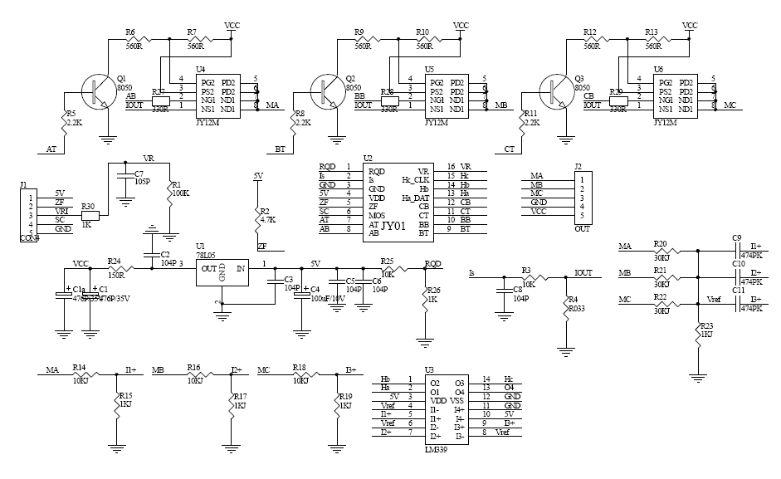
???
COMPARATOR

